Slide 1
F1 analysis
summary

Slide 2
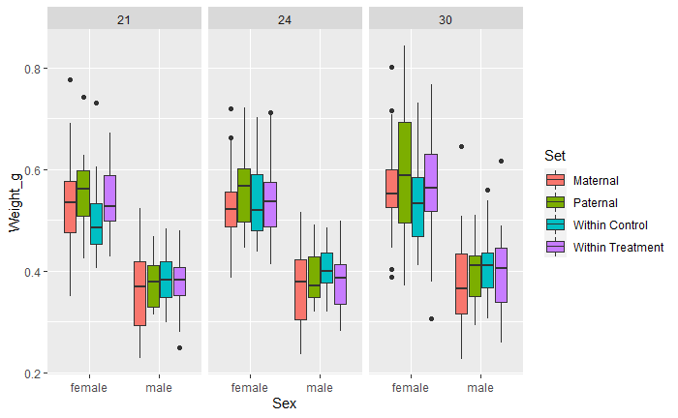
Weight

Slide 3
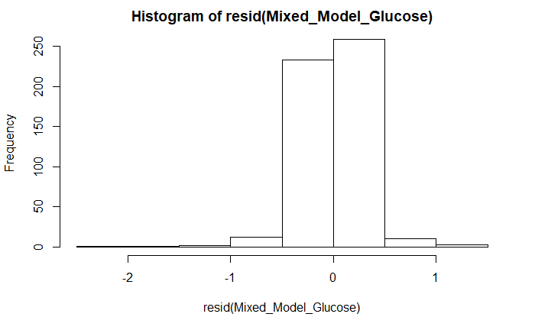
glucose
Predictors | Estimates | CI | p
(Intercept) | 3.28 | 3.02 – 3.54 | <0.001
Sexmale | -0.53 | -0.79 – -0.27 | 0.001
GroupPaternal | -0.26 | -0.61 – 0.09 | 0.225
GroupWithin Control | 0.32 | -0.03 – 0.68 | 0.138
GroupWithin Treatment | -0.35 | -0.70 – 0.00 | 0.106
Random Effects
σ² | 0.11
τ₀₀ _{Fish_ID} | 1.06
ICC _{Fish_ID} | 0.91
Observations | 521
Marginal R² / Conditional R² | 0.098 / 0.918

Slide 4
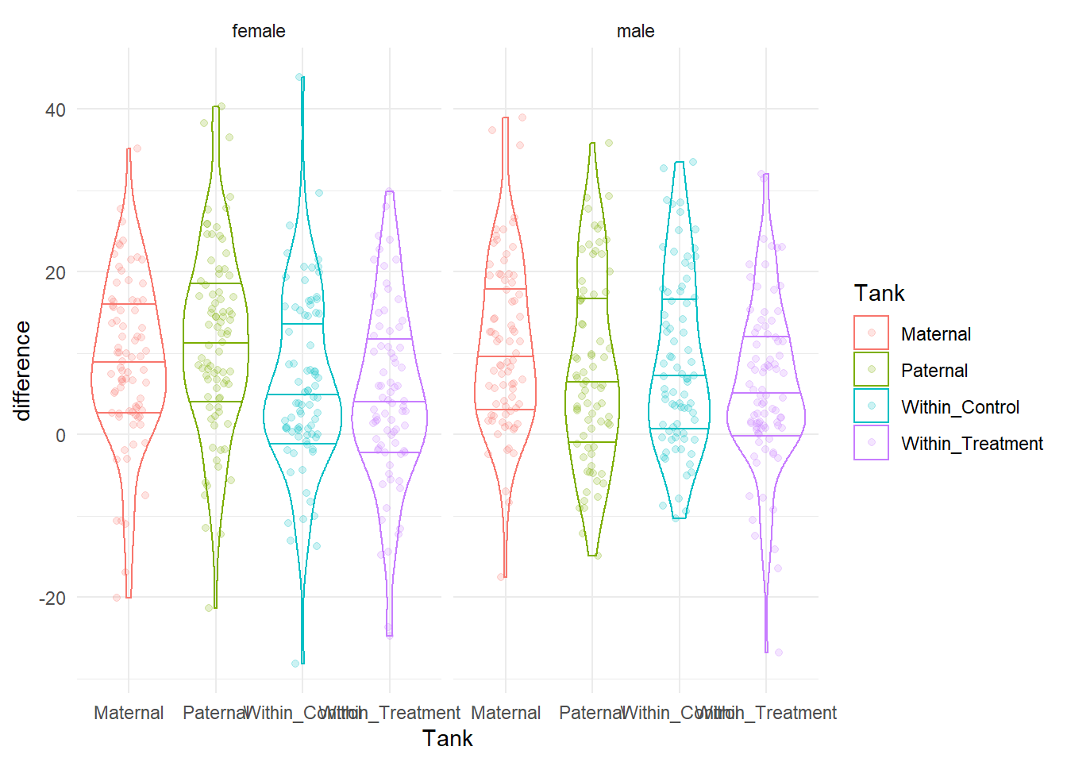
learning

Slide 5
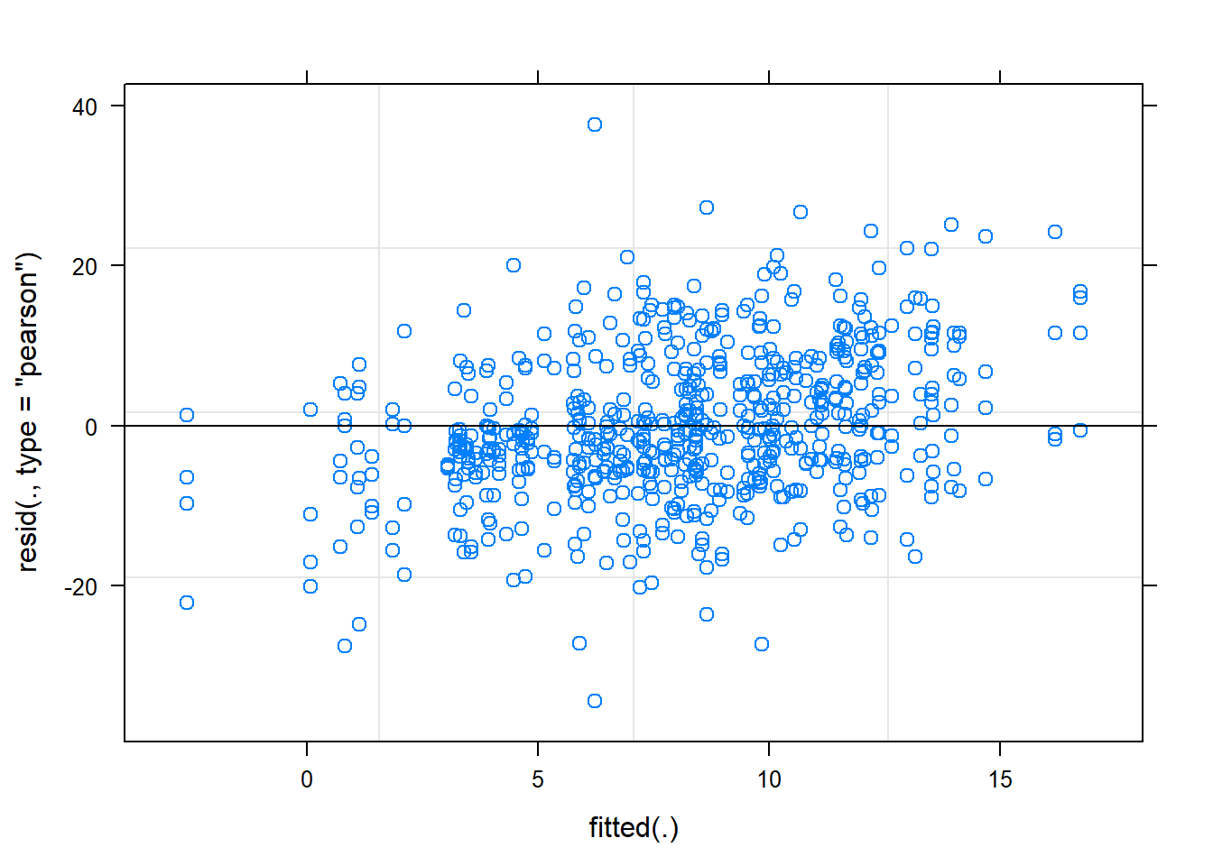
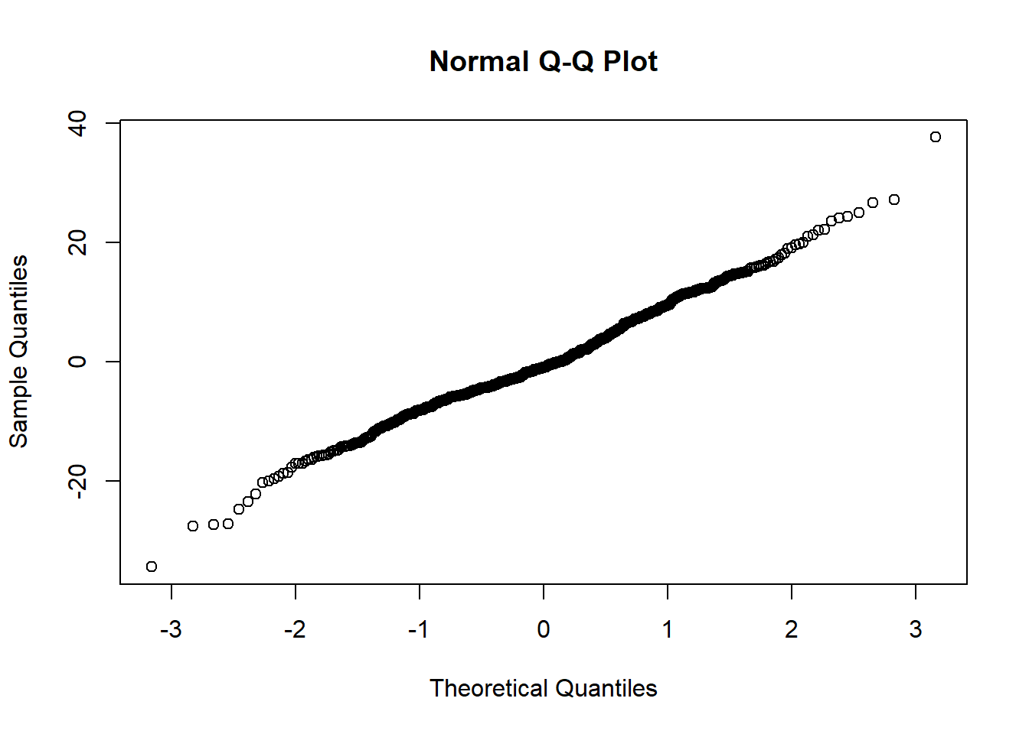
learning

Slide 6
learning
Predictors | Estimates | CI | p
(Intercept) | 9.60 | 7.29 – 11.90 | <0.001
TankPaternal | -0.19 | -3.11 – 2.72 | 0.896
TankWithin_Control | -2.36 | -5.28 – 0.55 | 0.114
TankWithin_Treatment | -4.58 | -7.49 – -1.66 | 0.002
sexmale | 0.53 | -1.53 – 2.59 | 0.616
Random Effects
σ² | 97.14
τ₀₀ _{fishID} | 20.01
ICC _{fishID} | 0.17
Observations | 639
Marginal R² / Conditional R² | 0.029 / 0.195

Slide 7
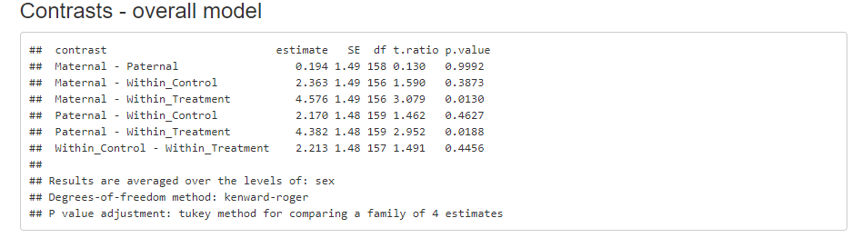
learning

Slide 8
plan
Complete body length measurements
Emulate F1 methods chapter analysis structure
Write methods section based on what I’ve already written (ADAPT)

